Slide 1
MINECOFIN Quarterly Macro-Fiscal Model (QMFM)
Quarterly Macro-Fiscal Outlook (QMFO)
Summary Outlook 2024-27
October 2025 Round

Slide 2
Outline/contents
Rationale of Outlook and underlying model
Recent macroeconomic developments
Initial conditions and assumptions for forecast
Macroeconomic forecast/outlook
Forecast evaluation (forecast comparison and effect recalibration)
QMFM interrelation with macro toolbox (nowcasting, intMF)

Slide 3
Acronyms
FPAS: Forecasting and Policy Analysis System (FPAS)
ER: Exchange Rate
RER: Real Exchange Rate
IB: Interbank interest rate
RIR: Real Interest Rate
NTF: Neal Term Forecast
MT and LT: Medium-Term Long-Term
YoY, %: Year on Year Percentage Change
G&S: goods and services (govt demand, exports, …)
WEO: World Economic Outlook (by IMF)
GAS: General Assumptions (in WEO)
GEE: General Economic Environment (in WEO)
CBO: Central Budget Office US

Slide 4
Glossary of key terms
Output gap & final demand gaps (+/-): output Y above/below potential or trend level Y*, i.e., output gap is log(Y/Y*) >< 0
Real interest & real exchange rate gaps: RIR and RER above/below neutral or equilibrium levels
Decomposition of macro aggregates by main drivers: coloured bars in charts show contribution of each
Fiscal deficit relevant for demand impact: deficit before grants = total expenditure -/- non/tax revenue
Debt anchor & sustainable deficit: debt ratio to GDP target (with LT growth, inflation rates, etc.) drives sustainable debt-creating deficit.
Fiscal stance expansionary/contractionary: deficit, govt demand G&S in % GDP above/below trend levels (“discretionary” deficit, demand ><0)
Fiscal impulse (on private demand): mainly discretionary fiscal deficit affecting consumption & investment (via income, ‘optimism’)
More/less restrictive monetary policies: (real) interest rates above/below neutral or trend levels
More/less restrictive exchange rate policies: real exchange rate below/above equilibrium or trend level
Role expectations: agents today consider expected macro variables and policies in future (expected inflation, exchange rate, demand gaps,…)
Forward-looking: one or four periods ahead behavioural expectations/speculations {+1} or {+4 Q}
Persistence: lag or effect of previous/initial values or behaviours
Trend (unobserved): trends of key macro variables are estimated; set steady state trends (to which variables converge in absence of shocks)
Shock: All other factors not captured by model equation or parameter specification
Decomposition (level, growth rate, % GDP): e.g., output (gap) by final demands, GDP growth by components, deficit % of GDP by revenue, exp.
Overvaluation and undervaluation

Slide 5
I. Rationale of outlook & underlying QMFM model
Regular forecasts 16 quarters ahead for key macro aggregates (i.e., output, inflation, final demands, ..) as influenced by fiscal, monetary, and exchange rate policies, incl. in response to shocks and new developments (scenario simulations)
Emphasis on fiscal and financing/debt policies and interaction with monetary and exchange rate policies, facilitating policy coordination between MINECOFIN and NBR
Input for validated macro-fiscal projections in intMF, underpinning MT budgets and IMF programs (checks on intMF)
Underlying macro model is New-Keynesian, ‘semi-structural, gap model, FPAS-type
Uses analysis of past observations and estimated trends to fit model to data; assesses initial condition for forecast
Forecast premises: policy stance (fiscal deficit path, current policy interest rate, and ER), assumptions on external environment, other exogenous, and near-term forecasts for GDP and CPI, depending on other tools and judgment
After shocks and policy responses have worked out, variables return gradually to their trends (long-term growth path), determined by their steady-state levels (outside model, e.g., potential output growth, equilibrium RER, RIR, CPI target, sustainable deficit).

Slide 6
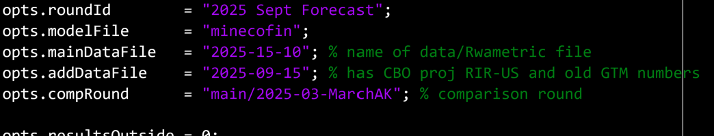
II. Data treatment & Settings
National Account (observed 2023Q2)
Omission/suppression of 2023-25Q1 for final demand components: dynamic volatility led to unreliable estimation of trend& gaps
Consumption, private investment, Export, import and imports
2025Q2 (rebased): YoY% change used for derivation of non-rebased real GDP levels
Filter estimation better than observed data for 2023-25 (levels) to derive corresponding trend, gap
2. Main Settings:
Filtration/estimation: opts.filterHistory.range = qq(2006, 1) : qq(2025, 2):
Fiscal Q2 2025
All other indicators (ER, IB rate, BOP) observed until 2025Q3
Extended filtration to 2025Q3 to capture nowcast
Forecast/estimation: opts.forecast.range = qq(2025, 3) : qq(2029, 4)

Slide 7
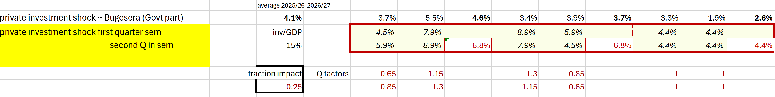
II. Main assumptions/tunes underlying forecasts
National Account:
GDP Nowcast for 2025Q3&4
2. ER: observed until 2025Q3 and Q4 tuned (remainder ER depreciation)
3.All indicators observed after 2025Q2(Filter range) tuned as data in baseline/forecast
4. Fiscal (Deficit, Revenue, Demand G&S, Other expense): Smoothed/distributed from FY/semester to Qo
October 2025 Rev Proj: Agreed projection path
Private investment (shock, %GDP): Smoothed/distributed from FY/semester to Qo
Other expense/NL/ow Bugesera Govt + Quatar Equity: directly affect growth
financing equity investments for Airport are fully invested in construction by private agents (ATL).
Govt equity or NL/ow Bugesera in other-expense still indirectly affect GDP growth (fiscal impulse) thru private investment demand

Slide 8
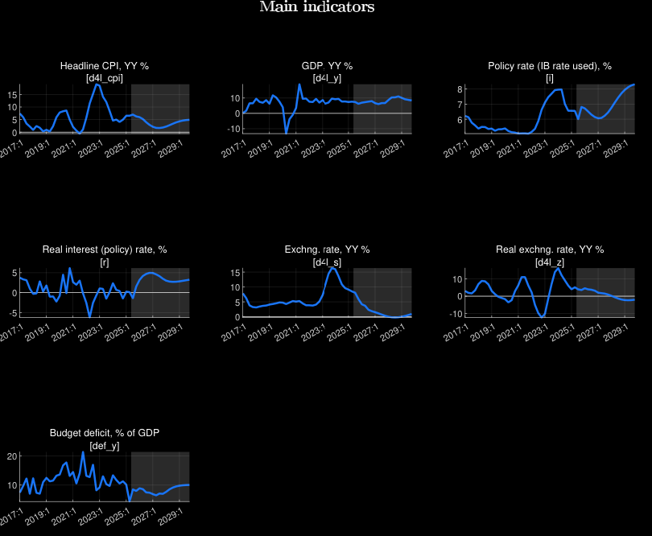
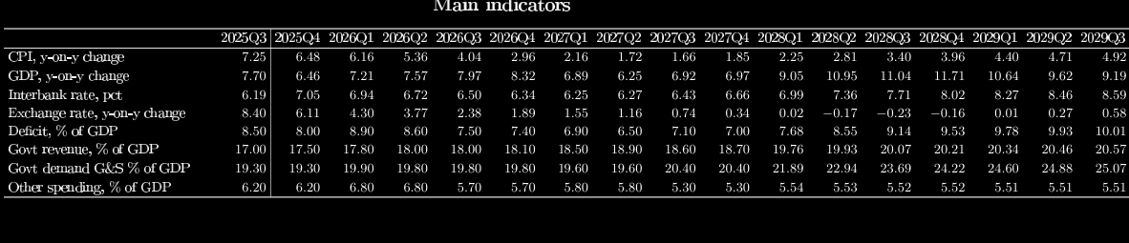
II. Forecast results: Baseline
Real GDP Growth Drivers: Final demand components
A fiscal deficit o/w Govt & Dem (NL Bugesera) in 2026-27 through private investment demand
With a fiscal consolidation to accommodate Bugesera
Govt dem increasing even after Bugesera (Less consolidation i.e.. higher gap inv)

Slide 9
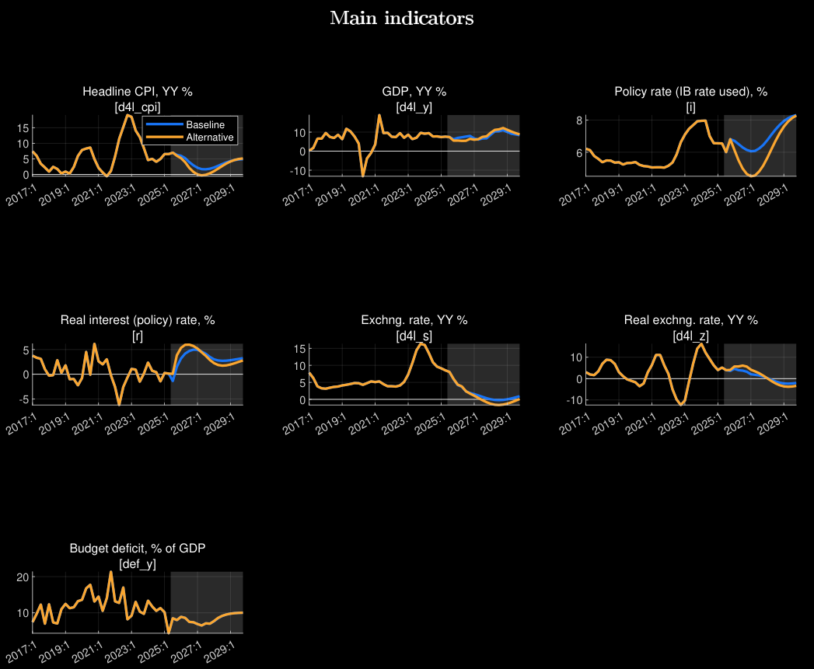
II. Forecast results: Alternative
Real GDP Growth Drivers: Private investment
Baseline: Private investment demand (Bugesera: Govt+Qatar equity)
Alternative: Otherwise
Direct effect of private investment demand prominent

Slide 10
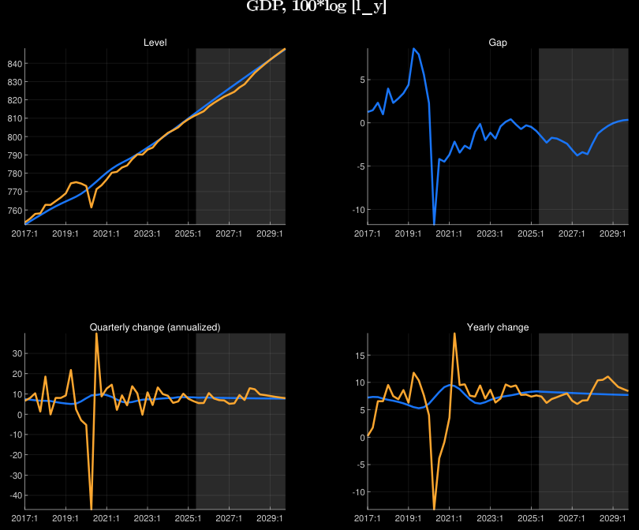
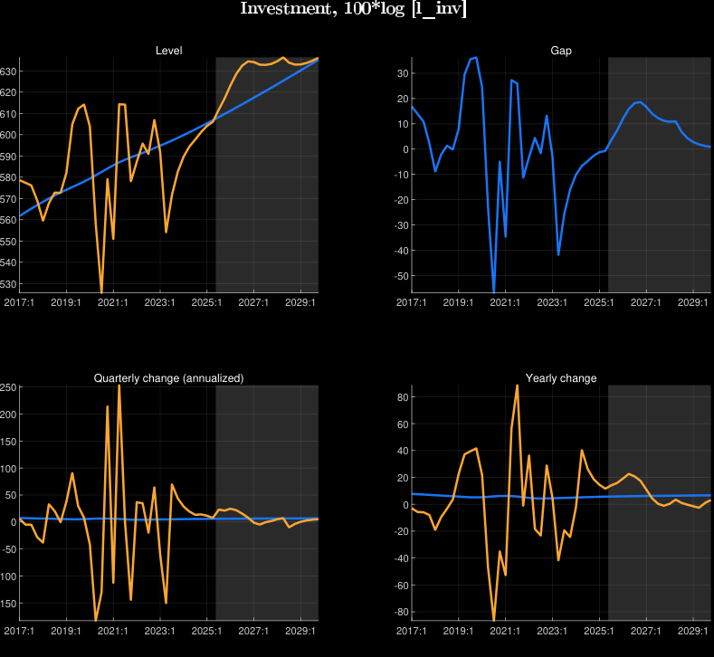
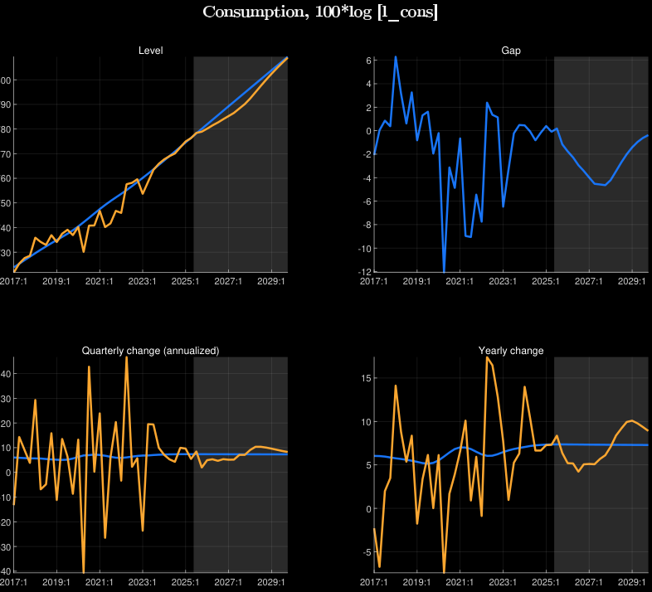
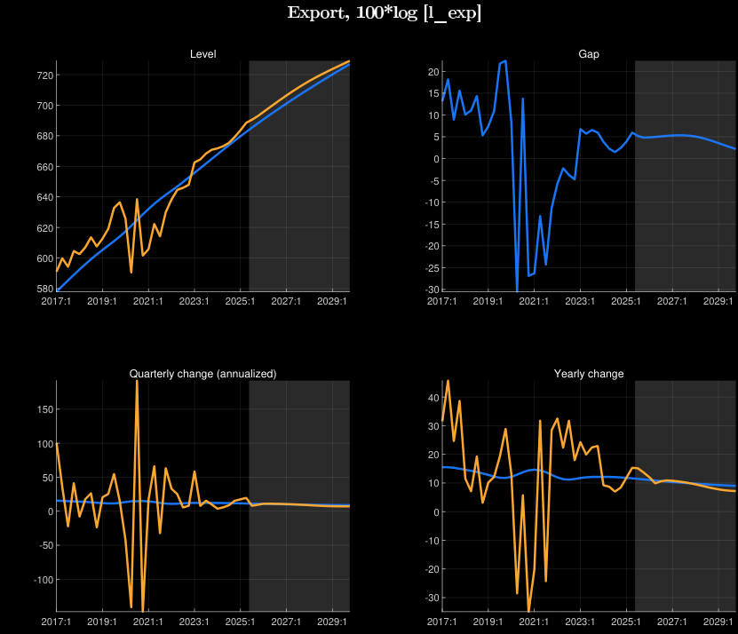
II. Forecast results: Cyclical position (B.C)
Real GDP Growth Drivers: Final demand components
Forecasted closing output gap from a positive investment and export demand cyclical position.

Slide 11
Discussions: responsive policy variables
Exchange rates: From 2025, ER forecast to return to ER target path of deprecation of some 3% per year, in line with inflation differentials, and no need for further RER depreciation, other things being equal
Forecast reflects NBR’s rule of return to ER path that first corrects for RER overvaluation, then for inflation differential with trading partners (+3% py).
2022-23 RER overvaluation (due to the inflation surge) was more than corrected in 2024
leading to some undervaluation in the course of 2024 and beyond, with positive impact on net exports
ER flexibility: no need for further policy/program exogenous corrections
Real interest rate:
Real interest rates return to normal ending their demand-stimulating effect in past years
Real lending rates mirror real policy rate through the transmission mechanism
Notes:
See Output gap and Fiscal Impulse in last Chart

Slide 12
VIII. Policies driving forecasts
Real Output growth:
Slowdown in 2026-27:
Fiscal policy: contraction fiscal policy—easing fiscal consolidation of demand (Capex) to accommodate Bugesera (i.e., NL/Govt equity)
direct positive fiscal impulse on private demand
Monetary policy: Tight Real interest rates contracting demand
Exchange rate: Further RER depreciation (moderately overvalued) to affect net exports.
Catch up in 2028-2030:
Fiscal policy: re-surfaced expansionary fiscal demand—end of fiscal consolidation (Govt demand pick up)
Monetary policy: Expansionary Real Interest Rate
Exchange rate: Flexible uncontrolled exchange rate (less overvalued)

Slide 13
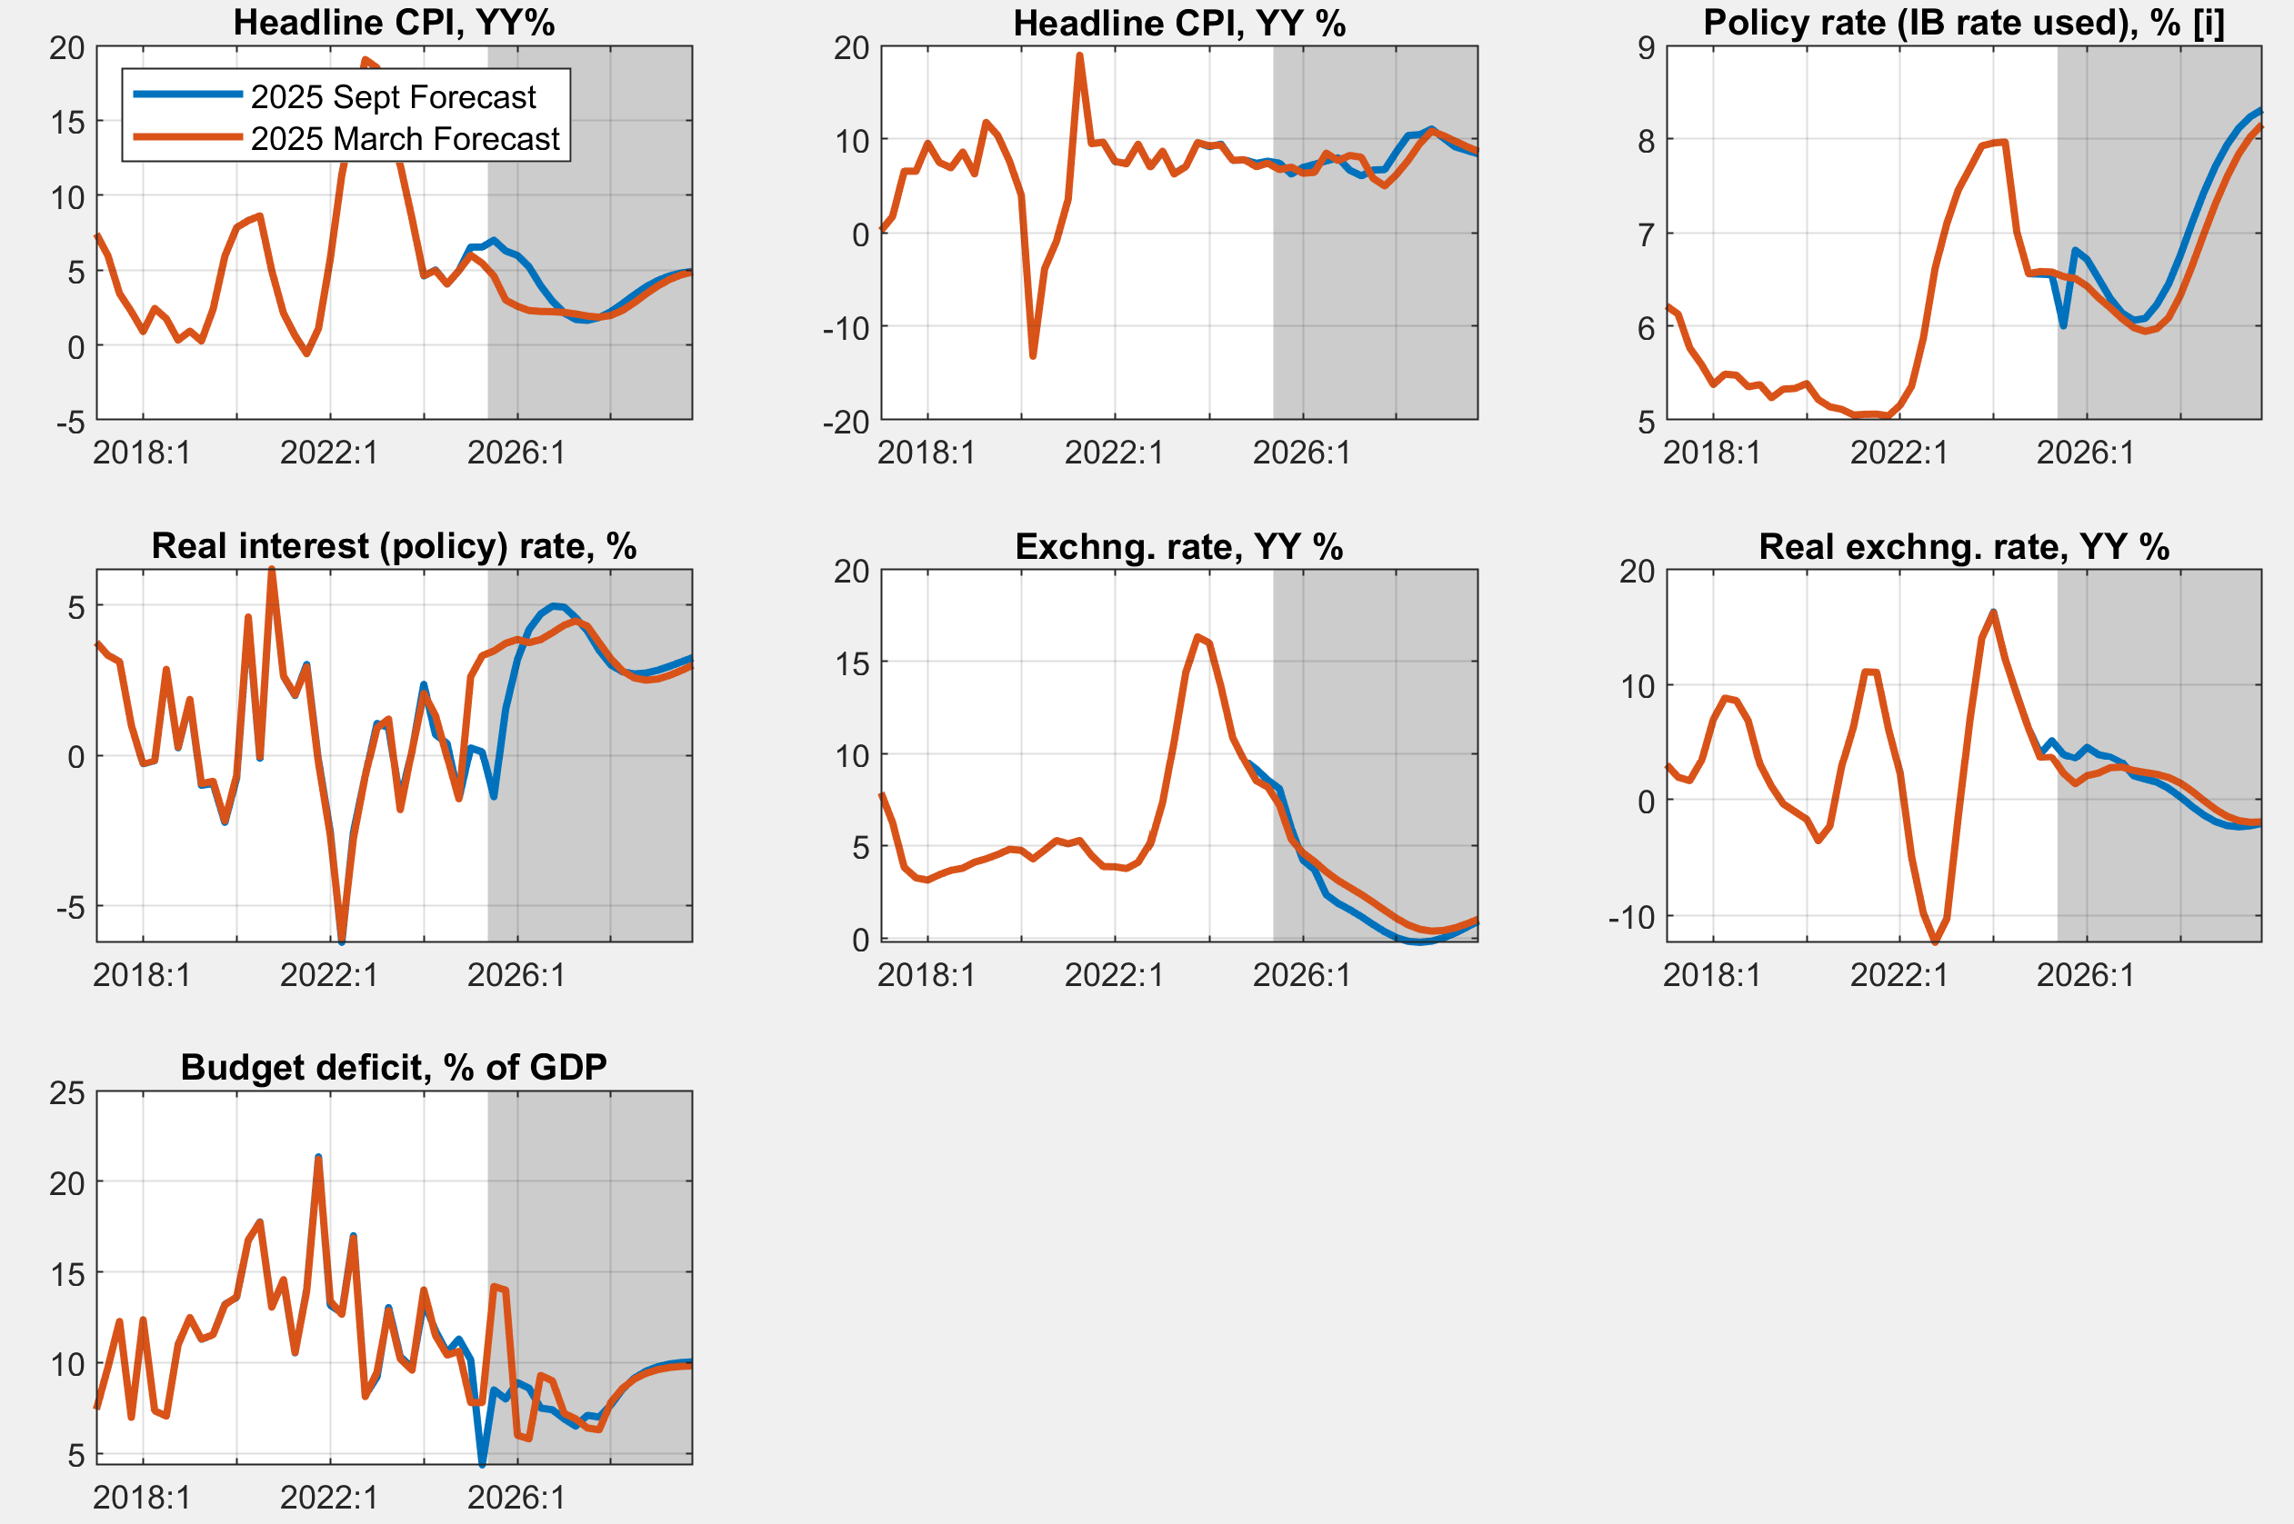
VII. Forecast evaluation (latest vs. new forecast)
Main indicators

Slide 14
THANK YOU

